Slide 1

Applied ML at Scale
Ulrich Paquet

Slide 3
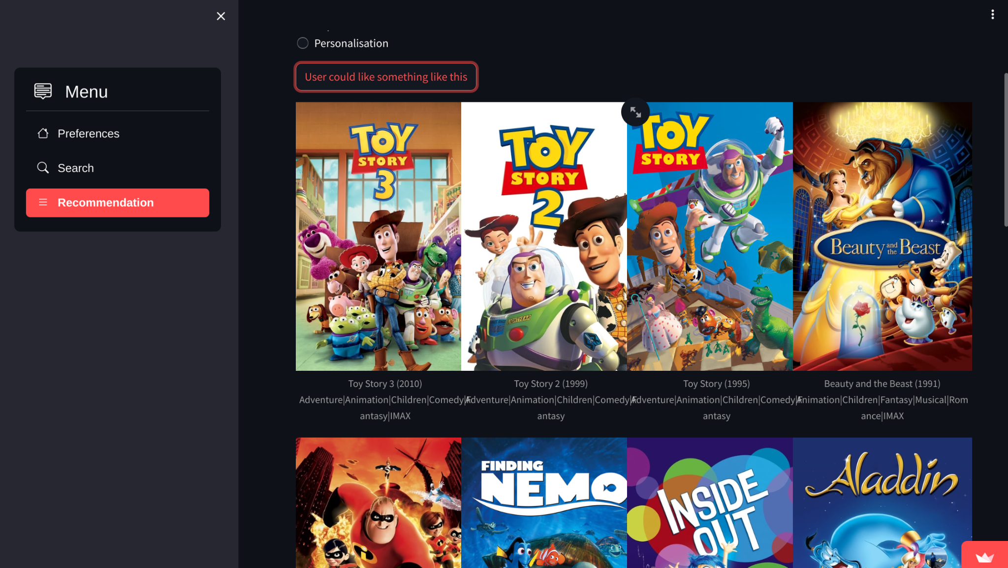
By: Yvan Marcel CARRÉ VILMORIN, AIMS 2024

Slide 4
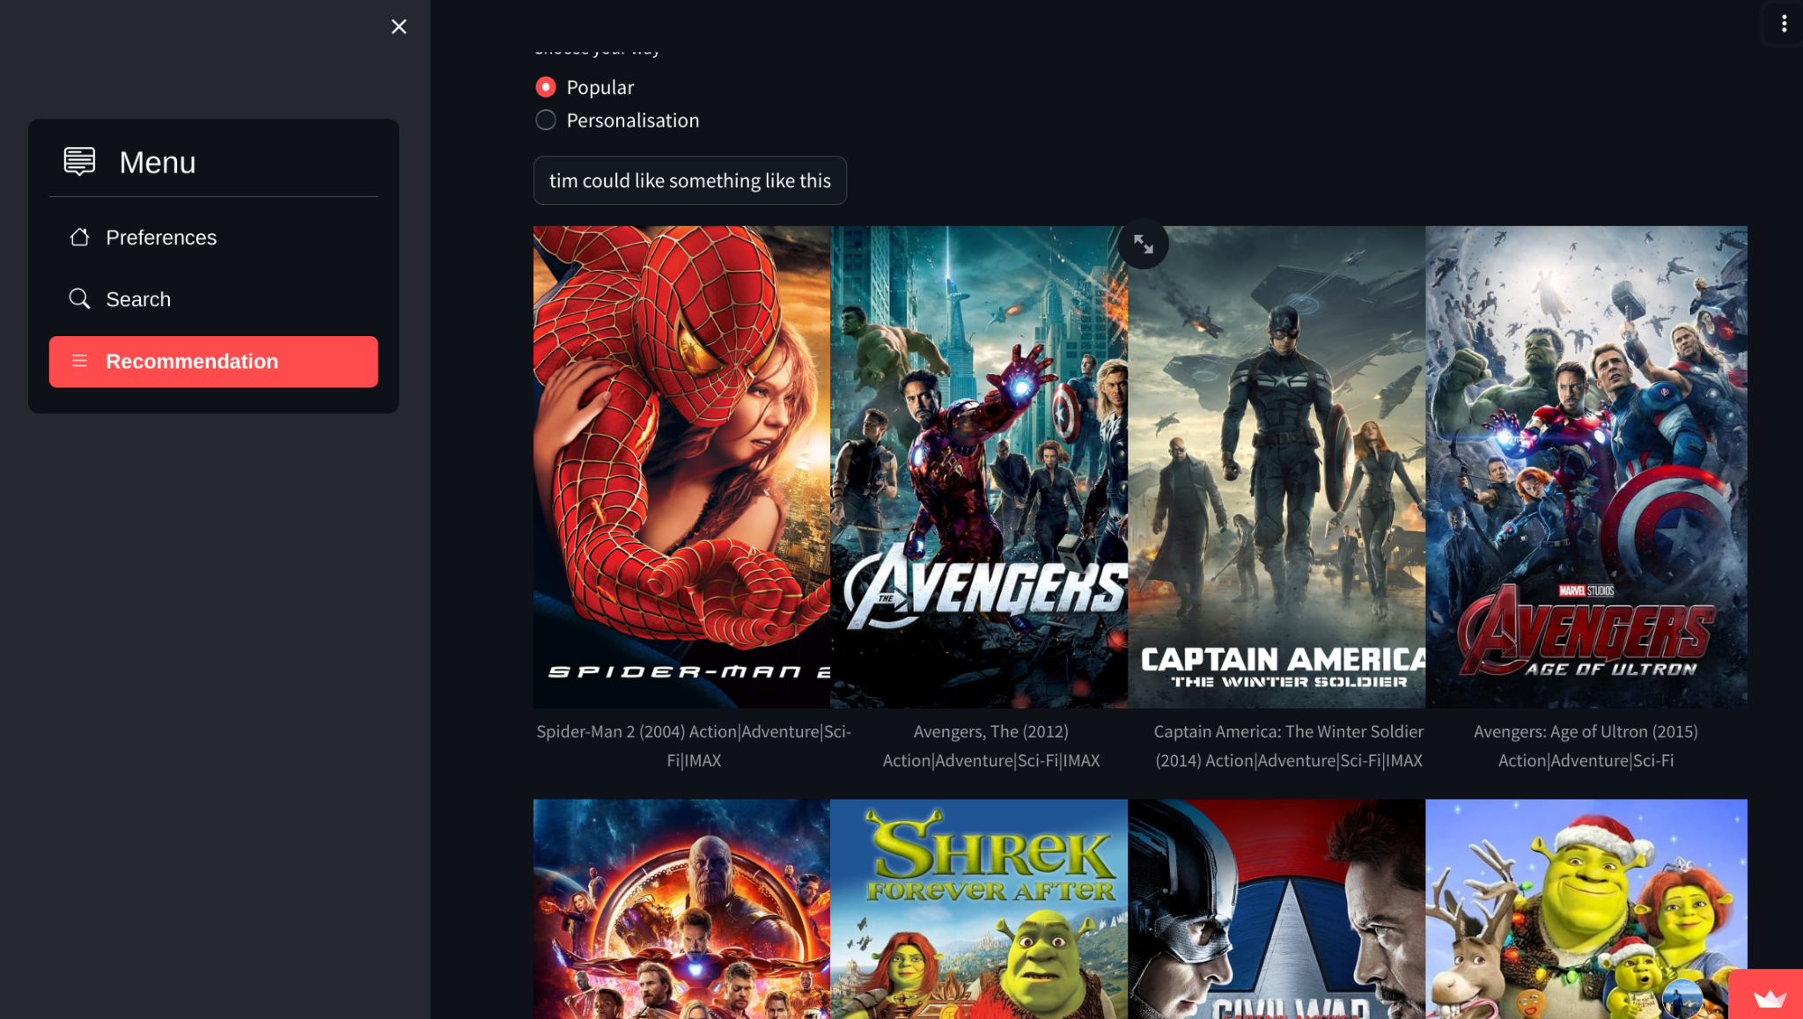
By: Yvan Marcel CARRÉ VILMORIN, AIMS 2024

Slide 5
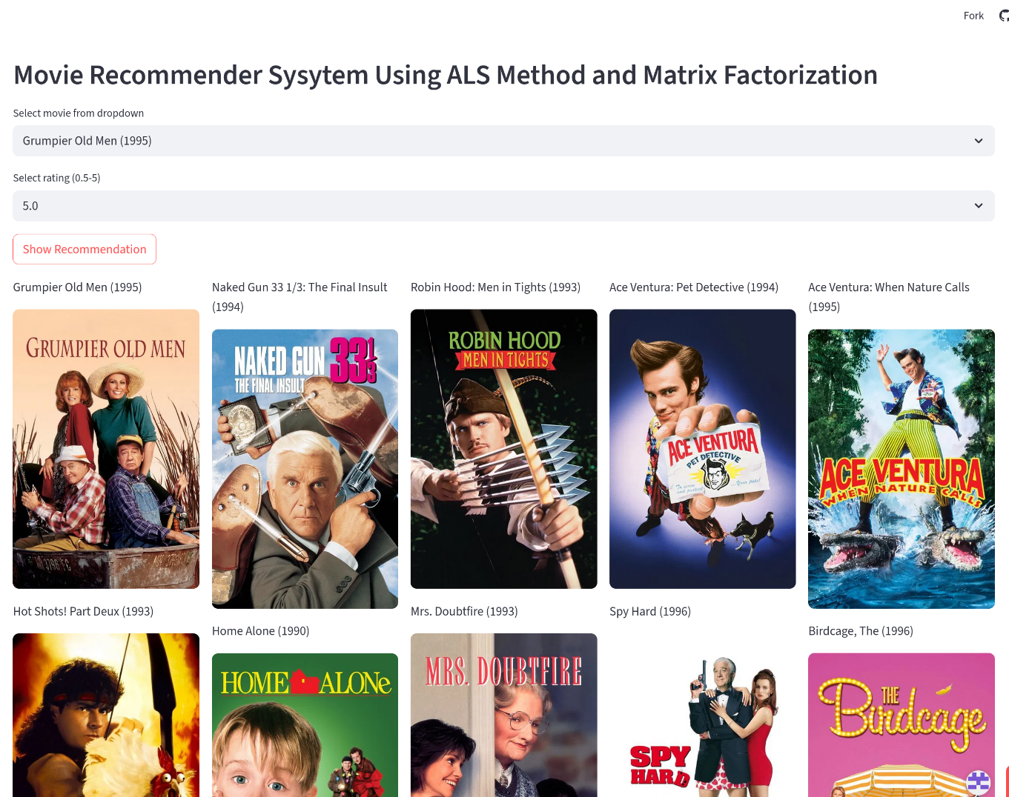
By: Emmanuel Kwame Ayanful, AIMS 2025

Slide 6
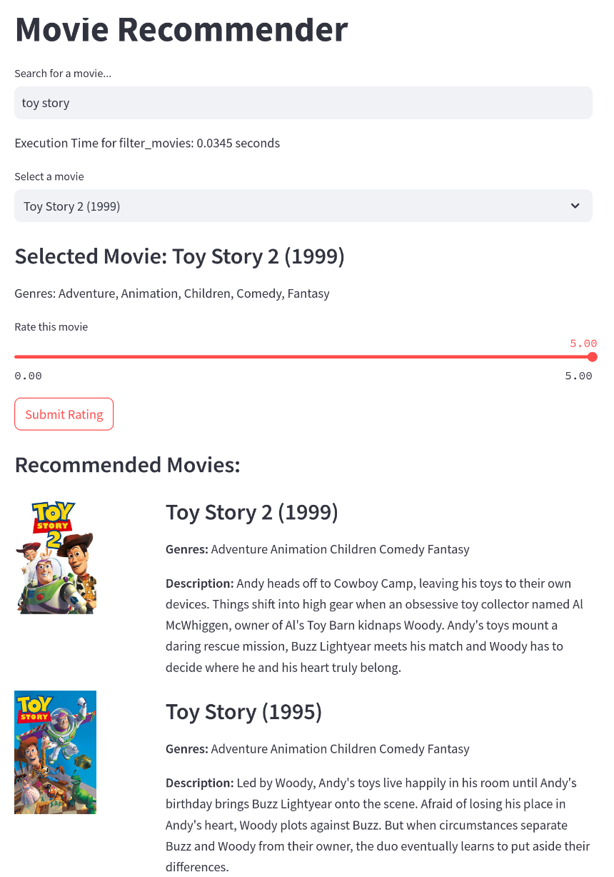
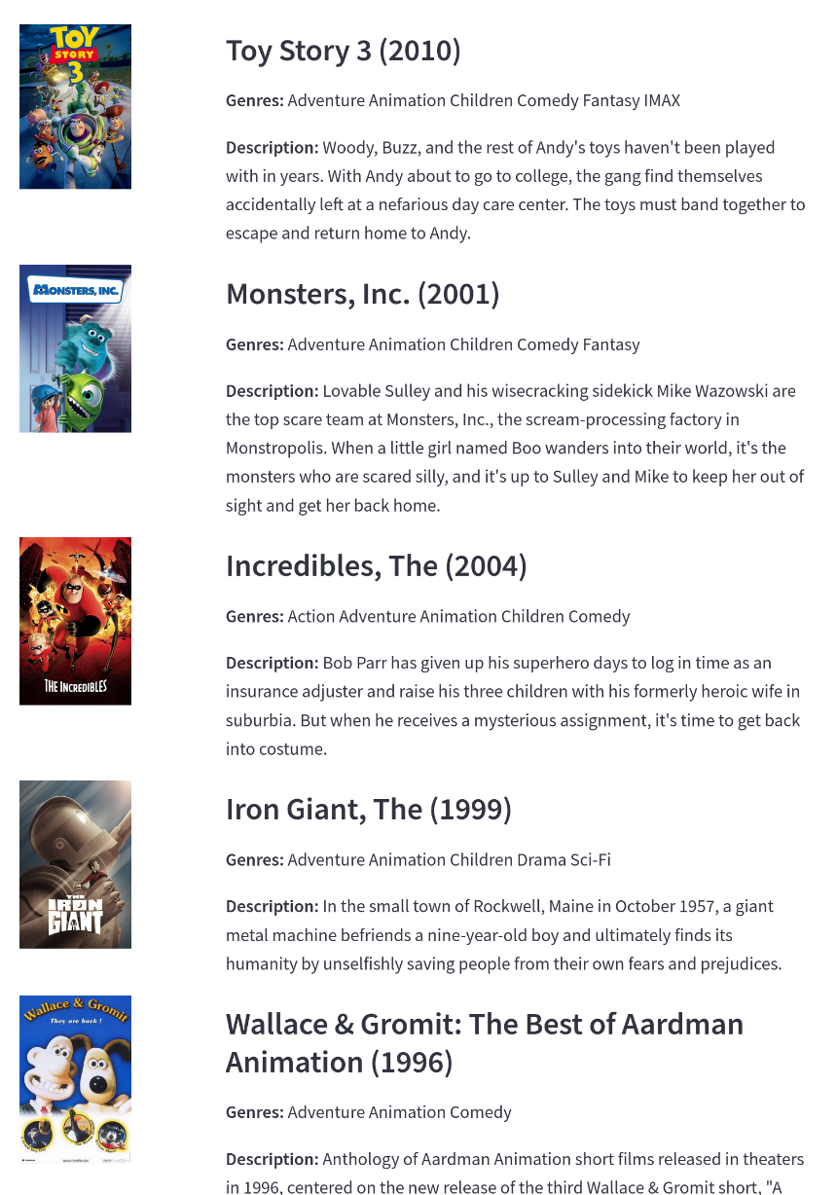
By: Isaac Houngue, AIMS 2025

Slide 7
The early days

Slide 8


The story of Greg Linden and Amazon recommendations
Notes:
The story of Greg Linden:
Early days of Amazon as an online book store– A bell rang each time a book was sold.
Greg Linden proposed candy rack book recommendations – “if you bought this, maybe also buy that…”
Company executives were mostly worried with churn. Customers leaving prior to making the actual payment.
Greg prototyped the feature but executive was objecting launching it.
Jeff Bezos said – if you can prove in the data that this works, we will launch the feature
An A/B test showed a significant increase in sales (up-sales) and a very small increase in churn
__________________________________________________
While he was at Amazon from 1997-2002, Greg Linden prototyped a system for making personal recommendations for other products to customers as they checked out.
Problem was, a marketing Senior Vice President thought these would distract customers from completing their purchase and didn’t think Linden had proof it would work. A business drama ensued; classic “gut versus data” stuff. “I heard the SVP was angry when he discovered I was pushing out a test,” recalled Linden in his blog. “But, even for top executives, it was hard to block a test. Measurement is good. The only good argument against testing would be that the negative impact might be so severe that Amazon couldn’t afford it. A difficult claim to make.”
Linden’s experiment ultimately showed that the customers really liked the feature, and recommendations have become a signature design feature for Amazon.

Slide 9
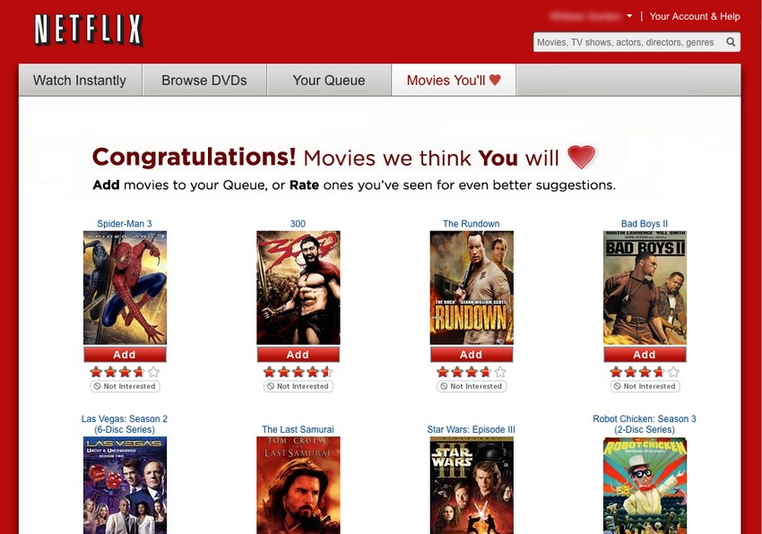
Netflix - Predicting Ratings
Notes:
The “original” Cinematch system

Slide 10
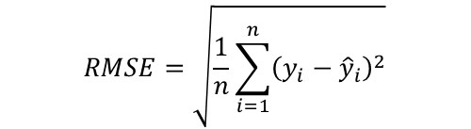
Long Ago… The Netflix Prize
The goal: 10% improvement in RMSE over Netflix’s Cinematch
It took tens of thousands of participants over 2 years….
Notes:
Serious academic interest in Recommender Systems really peaked during the Netflix Prize competition.
I think the history should actually starts somewhere with Greg Linden and Amazon or even before that…

Slide 11
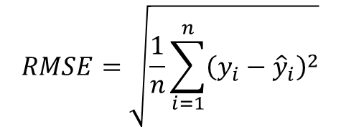
Netflix Prize – The Rules
A trivial “mean-score” prediction would yield a RMSE = 1.0540
Cinematch yielded a RMSE = 0.9514
A 10% improvement to win the grand prize meant a RMSE ≤ 0.8572
Notes:
The competition began on October 2, 2006.
On September 21, 2009, the grand prize of US$1,000,000 was given to the BellKor's Pragmatic Chaos team which bested Netflix's own algorithm for predicting ratings by 10.06%

Slide 12
Netflix Prize Timeline
October 2, 2006 – Competition started
After 6 days: Cinematch was beaten
After 1 week: First team qualified for the annual progress prize (1% over Cinematch)
After 1 year: Over 40,000 teams from 186 countries have joined
November 13, 2007 –Yehuda Koren, Robert Bell and Chris Volinsky from AT&T (BellKor) received the $50,000 progress prize with RMSE=0.8712 (8.43% improvement)
The 2008 progress prize was given to a joint solution by BellKor and BigChaos (Andreas Toscher and Michael Jahrer). RMSE=0.8616 and an assemble of 207 predictors sets.
June 26, 2009 – A merger of BellKor, BigChaos and Pragmatic Theory achieved a 10.05% improvement over Cinematch. The competition entered a 30-days “last call” period
July 26, 2009 – The competition stopped gathering submissions. The leaderboard showed:
The Ensemble with 10.10% improvement
BellKor’s Pragmatic Chaos with a 10.9% improvement
September 18, 2009 – Netflix announced BellKor’s Pragmatic Chaos as the winner of the competition. Their results matched those of The Ensemble but since they submitted 20 minutes later, the rules awarded the prize to BellKor.
Notes:
The competition began on October 2, 2006.
On September 21, 2009, the grand prize of US$1,000,000 was given to the BellKor's Pragmatic Chaos team which bested Netflix's own algorithm for predicting ratings by 10.06%

Slide 13
Netflix Prize Timeline
October 2, 2006 – Competition started
After 6 days: Cinematch was beaten
After 1 week: First team qualified for the annual progress prize (1% over Cinematch)
After 1 year: Over 40,000 teams from 186 countries have joined
November 13, 2007 –Yehuda Koren, Robert Bell and Chris Volinsky from AT&T (BellKor) received the $50,000 progress prize with RMSE=0.8712 (8.43% improvement)
The 2008 progress prize was given to a joint solution by BellKor and BigChaos (Andreas Toscher and Michael Jahrer). RMSE=0.8616 and an assemble of 207 predictors sets.
June 26, 2009 – A merger of BellKor, BigChaos and Pragmatic Theory achieved a 10.05% improvement over Cinematch. The competition entered a 30-days “last call” period
July 26, 2009 – The competition stopped gathering submissions. The leaderboard showed:
The Ensemble with 10.10% improvement
BellKor’s Pragmatic Chaos with a 10.9% improvement
September 18, 2009 – Netflix announced BellKor’s Pragmatic Chaos as the winner of the competition. Their results matched those of The Ensemble but since they submitted 20 minutes later, the rules awarded the prize to BellKor.
Notes:
The competition began on October 2, 2006.
On September 21, 2009, the grand prize of US$1,000,000 was given to the BellKor's Pragmatic Chaos team which bested Netflix's own algorithm for predicting ratings by 10.06%

Slide 14
Netflix Prize Timeline
October 2, 2006 – Competition started
After 6 days: Cinematch was beaten
After 1 week: First team qualified for the annual progress prize (1% over Cinematch)
After 1 year: Over 40,000 teams from 186 countries have joined
November 13, 2007 –Yehuda Koren, Robert Bell and Chris Volinsky from AT&T (BellKor) received the $50,000 progress prize with RMSE=0.8712 (8.43% improvement)
The 2008 progress prize was given to a joint solution by BellKor and BigChaos (Andreas Toscher and Michael Jahrer). RMSE=0.8616 and an assemble of 207 predictors sets.
June 26, 2009 – A merger of BellKor, BigChaos and Pragmatic Theory achieved a 10.05% improvement over Cinematch. The competition entered a 30-days “last call” period
July 26, 2009 – The competition stopped gathering submissions. The leaderboard showed:
The Ensemble with 10.10% improvement
BellKor’s Pragmatic Chaos with a 10.9% improvement
September 18, 2009 – Netflix announced BellKor’s Pragmatic Chaos as the winner of the competition. Their results matched those of The Ensemble but since they submitted 20 minutes later, the rules awarded the prize to BellKor.
Notes:
The competition began on October 2, 2006.
On September 21, 2009, the grand prize of US$1,000,000 was given to the BellKor's Pragmatic Chaos team which bested Netflix's own algorithm for predicting ratings by 10.06%

Slide 15
Introduction | Reading list
Yehuda Koren’s Matrix Factorization Techniques for Recommender Systems
Step by step: Yahoo! Music Recommendations: Modeling Music Ratings with Temporal Dynamics and Item Taxonomy
The Xbox Recommender System

Slide 16
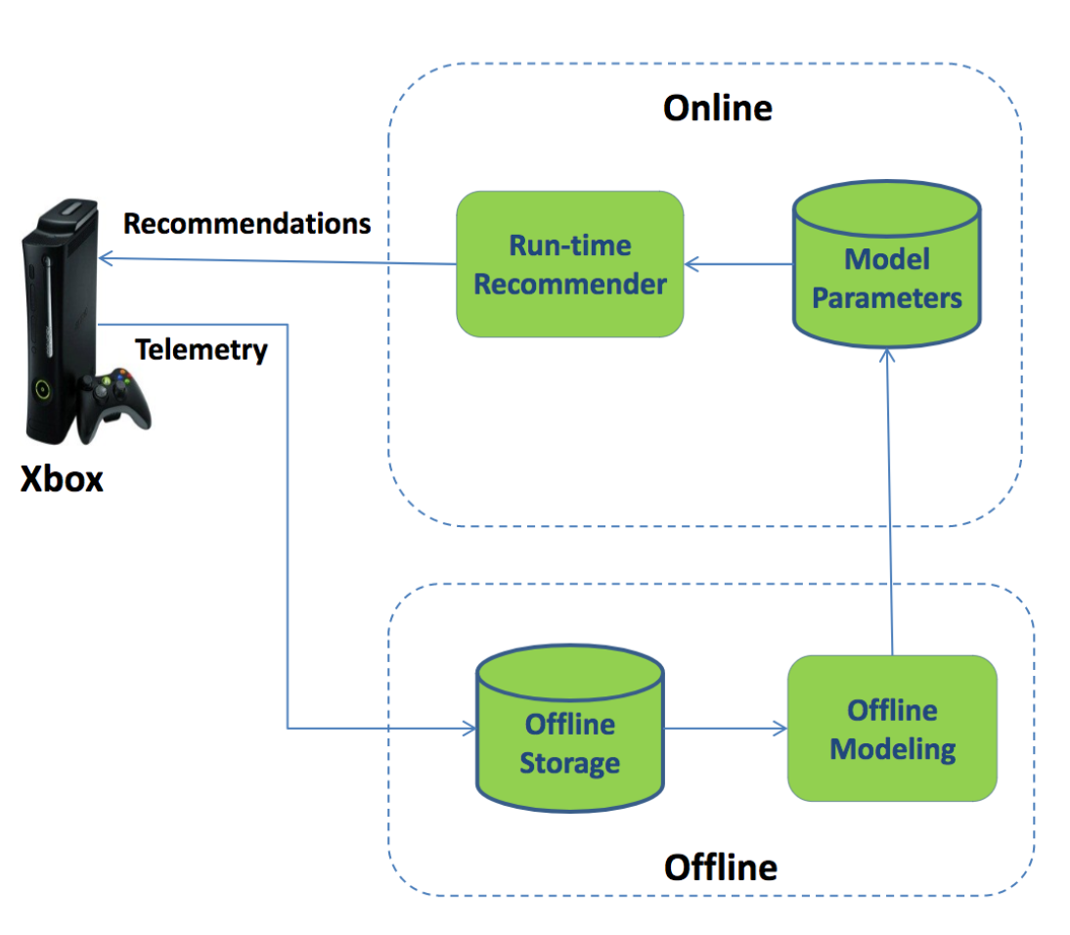
A new component in Xbox 360

Slide 17



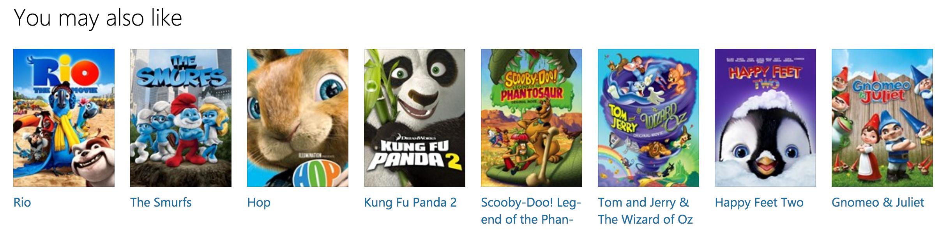
The goal

Slide 18
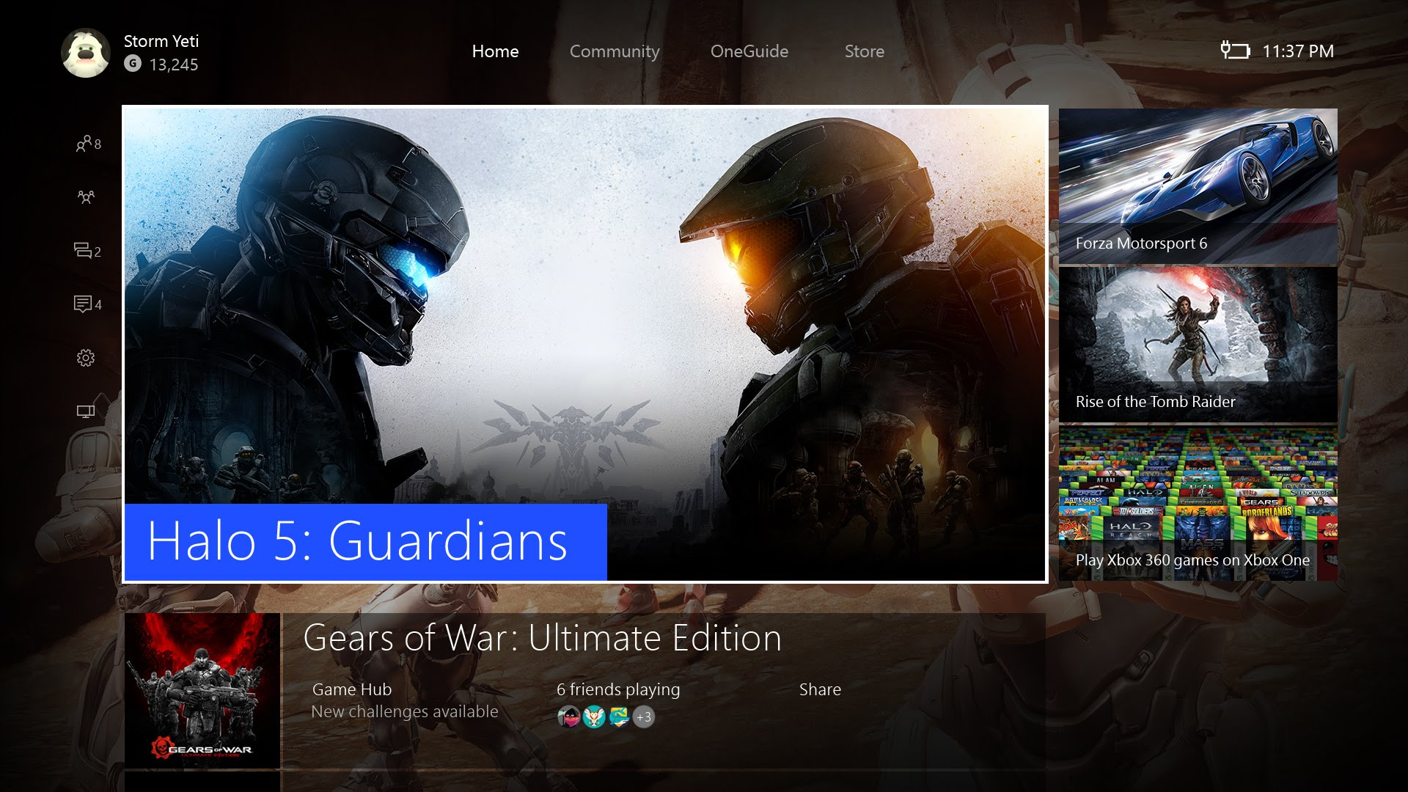

Slide 19





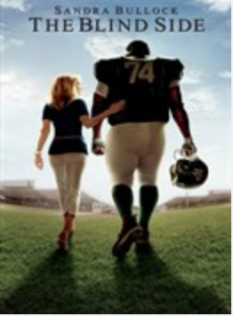
The kind of
data

Slide 20
Degree distributions
d=1
d=2
d=1
d=1
d=2
d=2
d=1
d=2
d=2

Slide 21
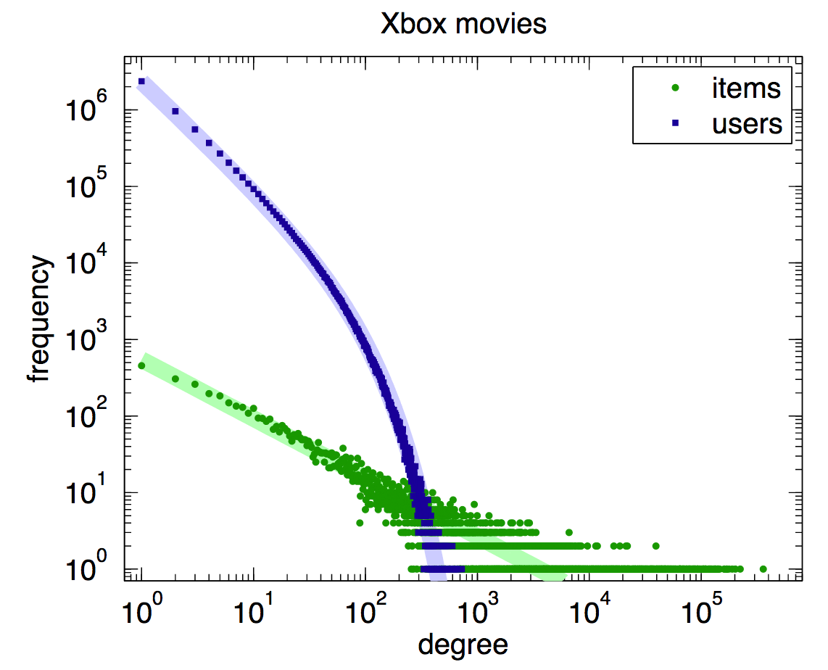
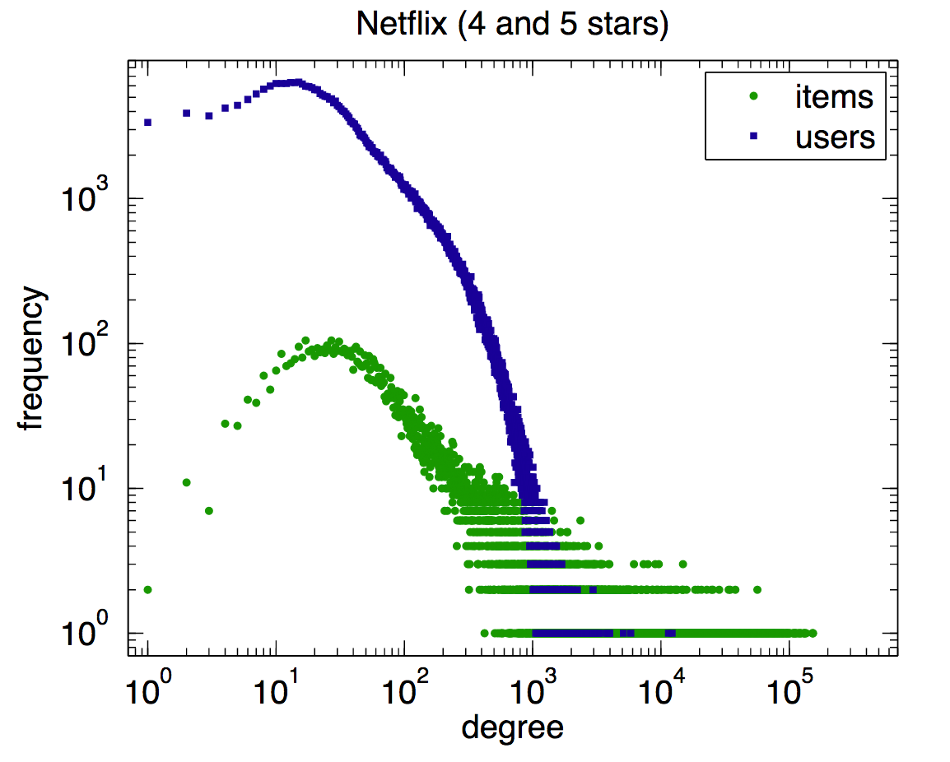
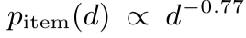
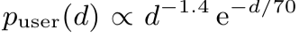
Power laws
The least popular movie

Slide 22

A good read
http://networksciencebook.com/

Slide 23
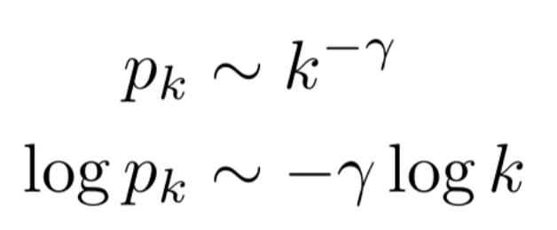
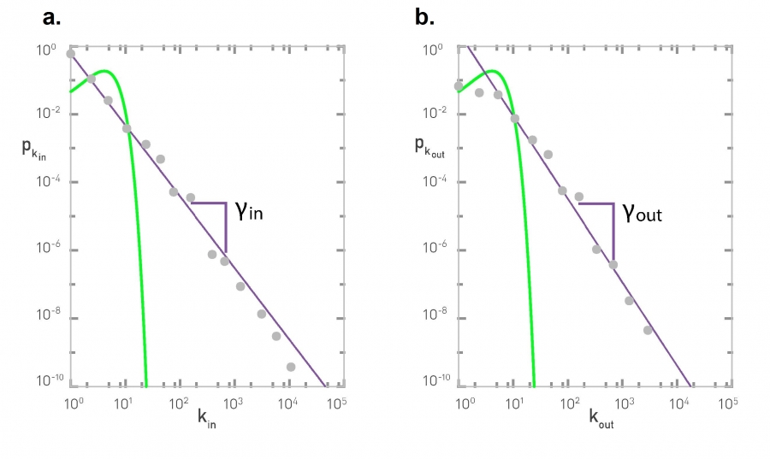
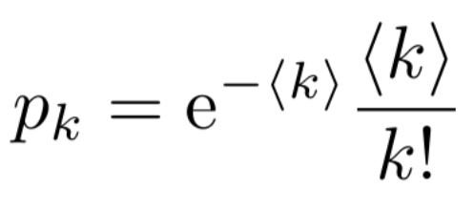
Power laws and scale free networks
The probability p_{k} that a node has exactly k links (degree) is:
The Degree Distribution of the WWW
The incoming (a) and outgoing (b) degree distribution of the WWW sample mapped in the 1999 study of Albert et al. [1]. The degree distribution is shown on double logarithmic axis (log-log plot), in which a power law follows a straight line. The symbols correspond to the empirical data and the line corresponds to the power-law fit, with degree exponents γ_{in}= 2.1 and γ_{out} = 2.45. We also show as a green line the degree distribution predicted by a Poisson function with the average degree 〈k_{in}〉 = 〈k_{out}〉 = 4.60 of the WWW sample.
Poisson
Source: Network Science, Albert-László Barabási

Slide 24
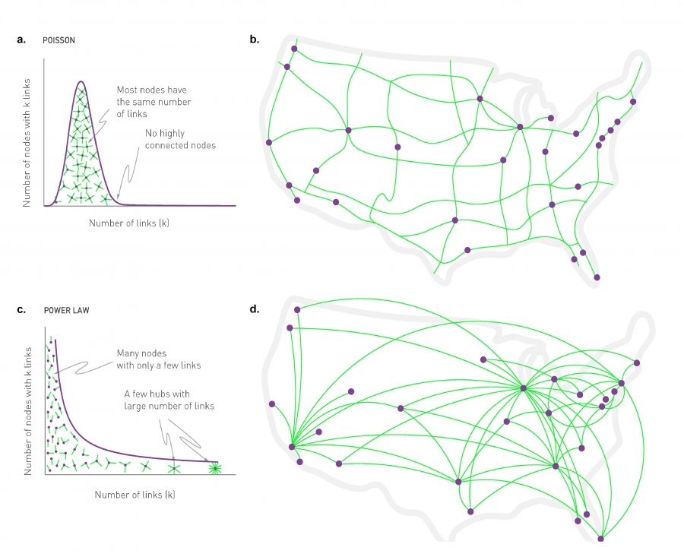
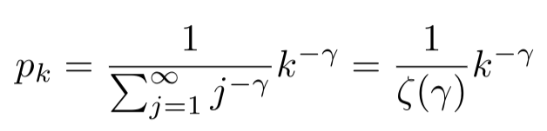
The probability p_{k} that a node has exactly k links; special case for p₀.
Source: Network Science, Albert-László Barabási

Slide 25
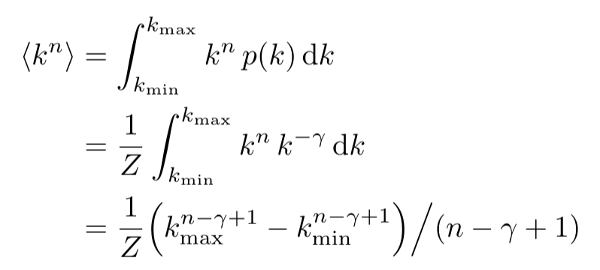
Power laws and scale free networks
Lack of an Internal Scale
For any exponentially bounded distribution, like a Poisson or a Gaussian, the degree of a randomly chosen node is in the vicinity of 〈k〉. Hence 〈k〉 serves as the network’s scale.
For a power law distribution the second moment can diverge, and the degree of a randomly chosen node can be significantly different from 〈k〉. Hence 〈k〉 does not serve as an intrinsic scale. A network with a power law degree distribution lacks an intrinsic scale…
The degree of the largest hub, k_{max}, increases with the system size
To understand the behavior of 〈k^{n}〉 we need to take the asymptotic limit k_{max} → ∞.
All moments larger than γ−1 (i.e. n−γ+1 > 0) diverge
Source: Network Science, Albert-László Barabási

Slide 26
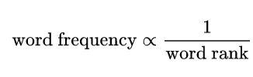
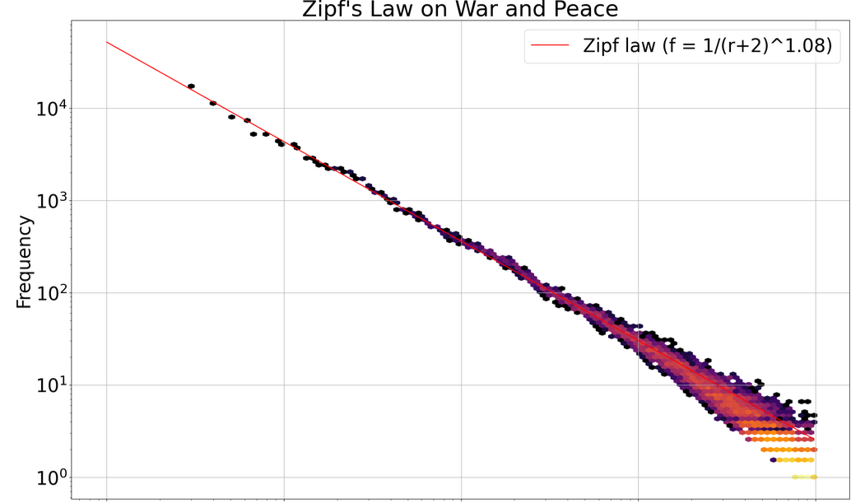
Zipf’s law
The most popular word

Slide 27
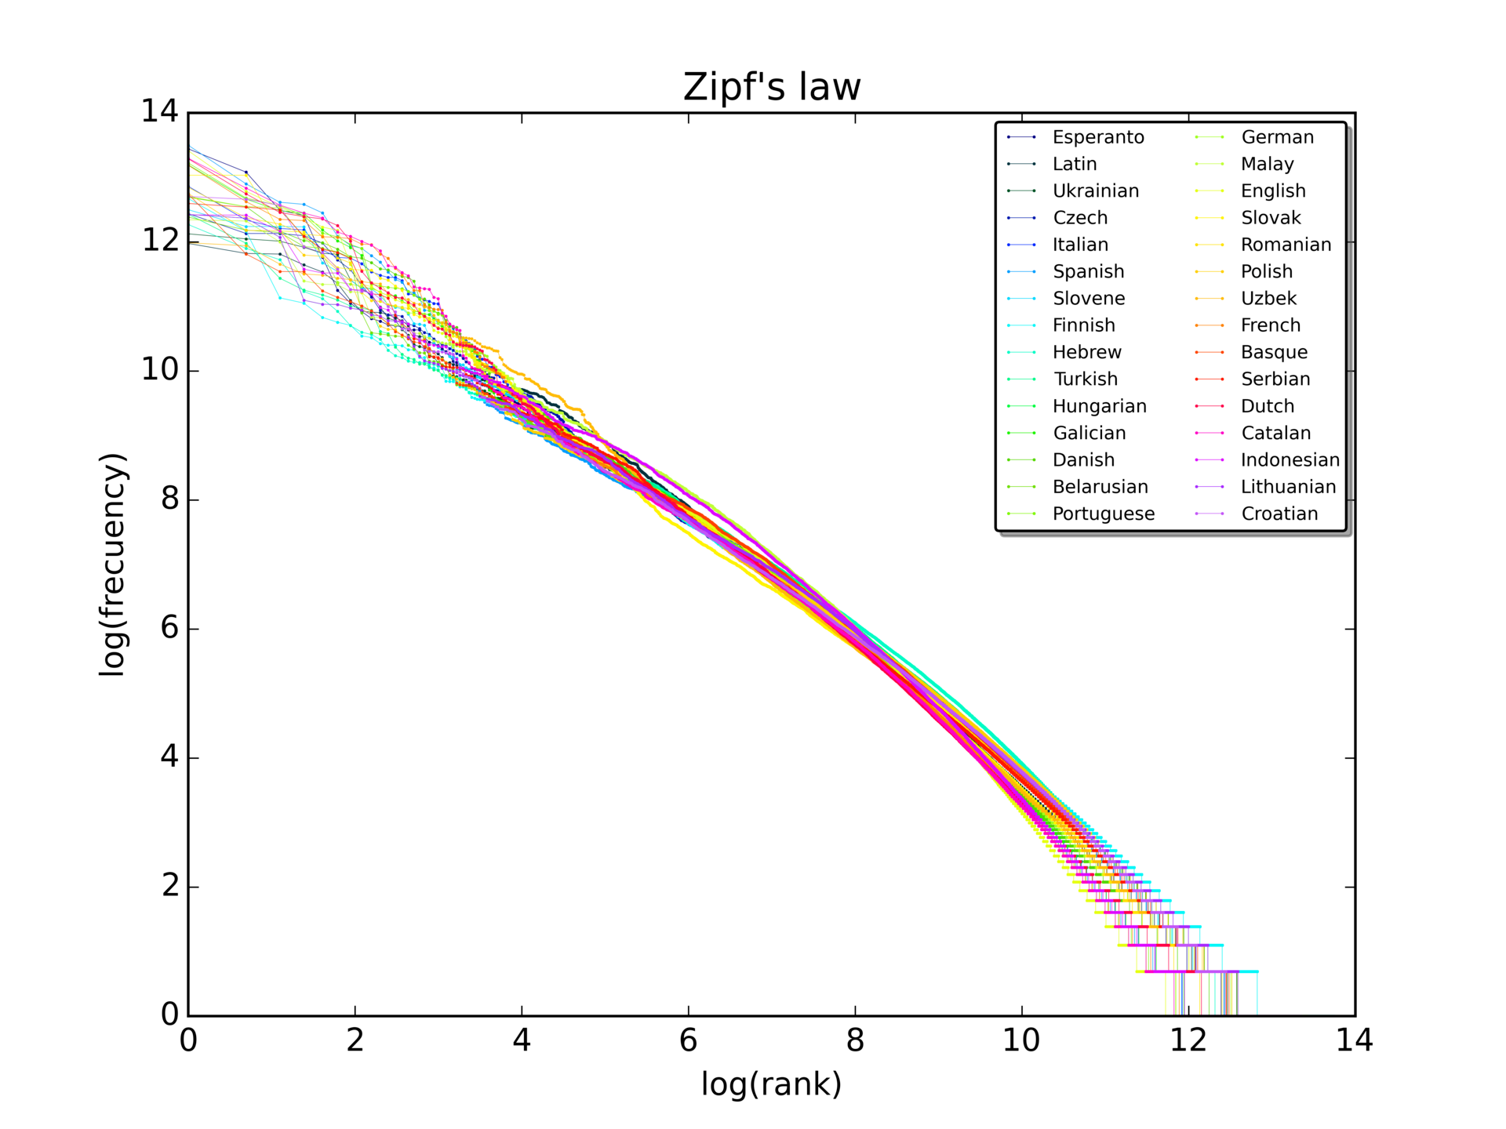
Zipf’s law
Zipf's law plot for the first 10 million words in 30 Wikipedias (as of October 2015) in a log-log scale.

Slide 28
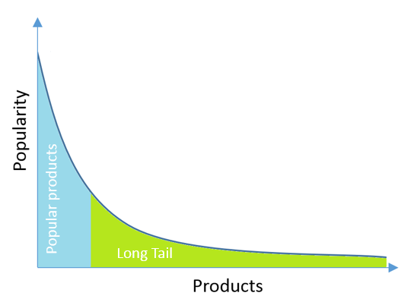
Power law distributions in online data
A lot of “content” here (e.g. many products); heavy tail

Slide 29
Approaches
[ adventure, animated, boys, cars, kids ]
[ 0 1 1 0 0 1 0 0 0 0 0 1 0 0 0 1 0 0 0 0 ]
Feature-based
Nearest neighbour-based
Collaborative filtering
and then blending them
Modern approaches based on reinforcement learning, maximizing an expected “future reward”
[ adventure, animated, anti-hero, kids ]
[ 0 1 1 0 1 0 0 0 0 0 0 0 0 0 0 1 0 0 0 0 ]

Slide 30
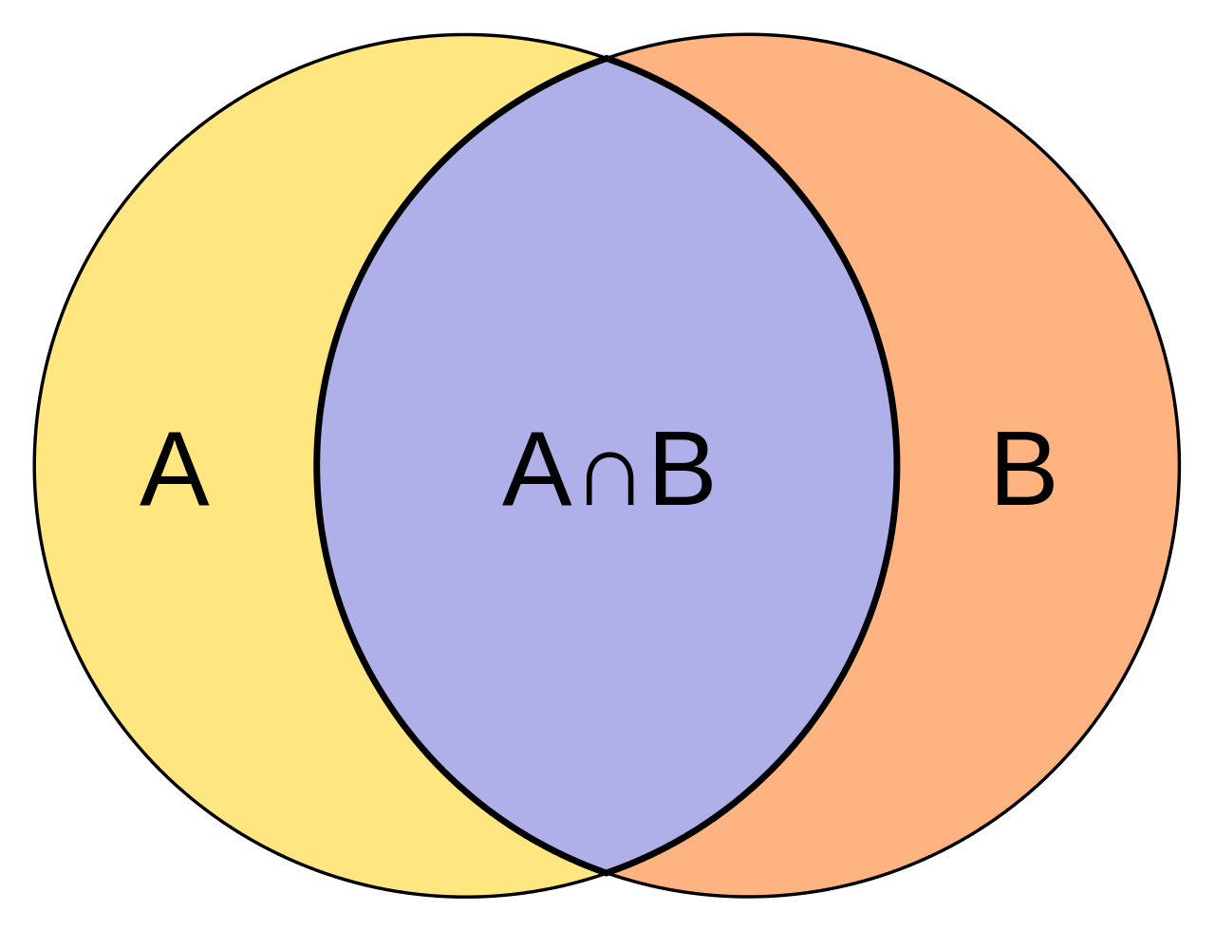
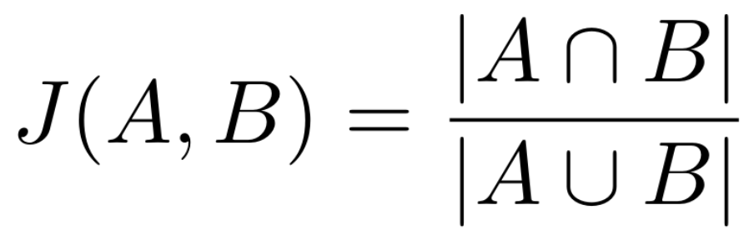
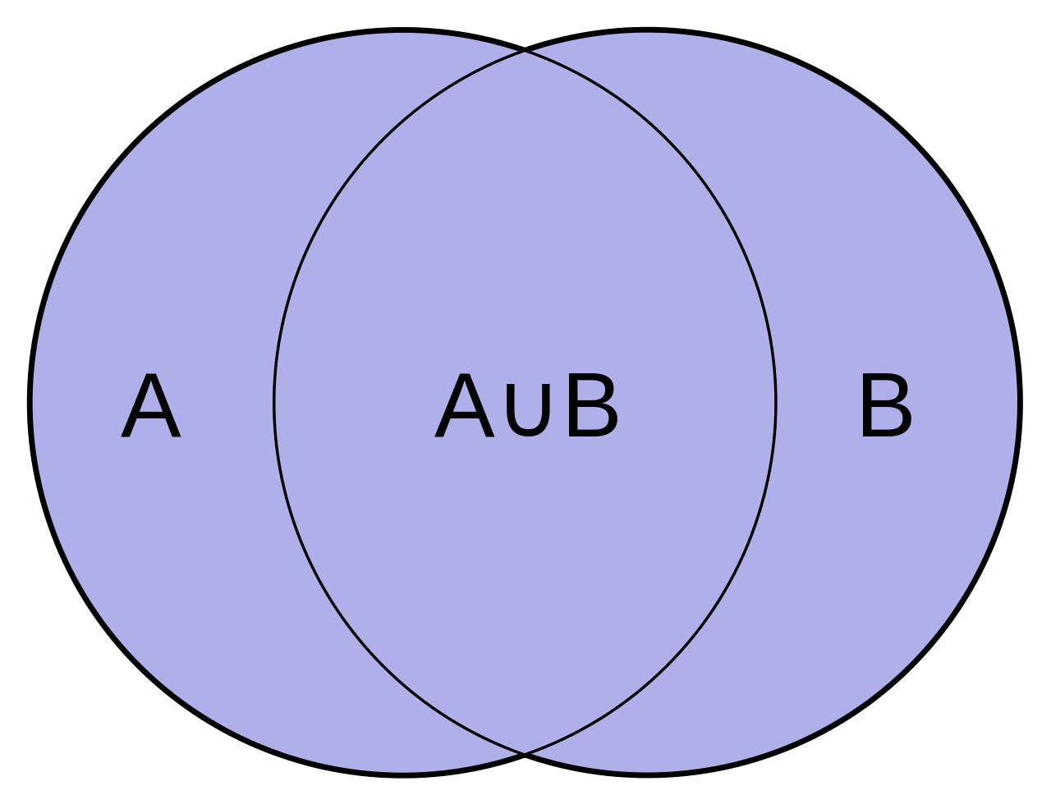
Approaches
[ adventure, animated, boys, cars, kids ]
[ 0 1 1 0 0 1 0 0 0 0 0 1 0 0 0 1 0 0 0 0 ]
Feature-based
Jaccard similarity
[ adventure, animated, anti-hero, kids ]
[ 0 1 1 0 1 0 0 0 0 0 0 0 0 0 0 1 0 0 0 0 ]

Slide 31
Xbox movies
and games
2010, 2011
The early days
✓
✓
✓
✓
✓
✓
TBs of interaction logs
✓

Slide 32
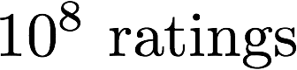
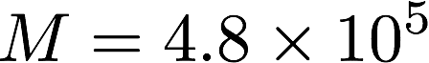
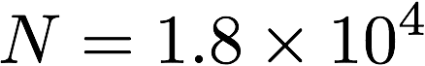
The Netflix
Prize
2007
The really early days
5
4
5
$1M prize money for best test RMSE :)
1x solution per 24 hours
Winning entries not a single model, but ensemble of many models...
5
3
2
3
5

Slide 33
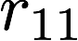
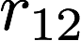
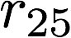
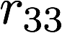
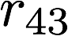
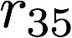
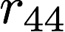

Slide 35
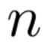
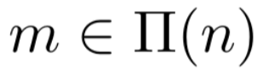
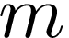
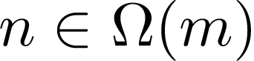
Indexing twice
1
1
1
1
2
2
1
2
5
3
3
4
3
3
5
4
4
4
3
4
5
2
3

Slide 36
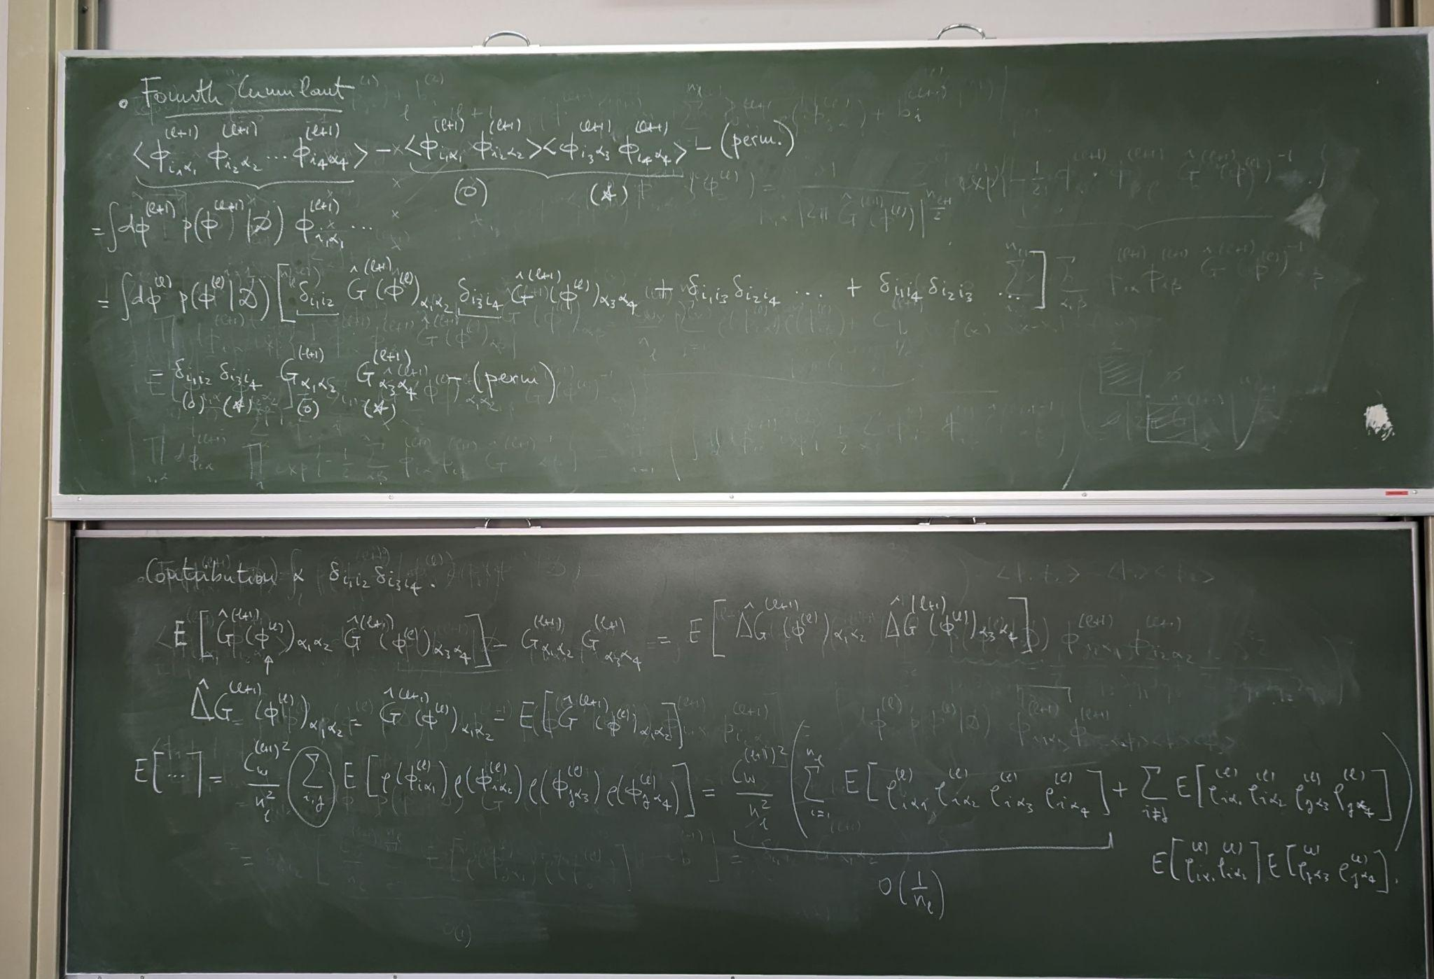
Practical 1
Understanding the data and the problem

Slide 37
Practical 1 | Reading list
Read:
✅ Yehuda Koren’s Matrix Factorization Techniques for Recommender Systems
✅ Step by step: Yahoo! Music Recommendations: Modeling Music Ratings with Temporal Dynamics and Item Taxonomy
✅ The Xbox Recommender System

Slide 38
Practical 1
✅ Download the MovieLens 32M data set and understand its README
Dataset examples
movies.csv
movieId,title,genres
1,Toy Story (1995),Adventure|Animation|Children|Comedy|Fantasy
2,Jumanji (1995),Adventure|Children|Fantasy
3,Grumpier Old Men (1995),Comedy|Romance
tags.csv
userId,movieId,tag,timestamp
3,260,classic,1439472355
3,260,sci-fi,1439472256
4,1732,dark comedy,1573943598
4,1732,great dialogue,1573943604
ratings.csv
userId,movieId,rating,timestamp
1,296,5.0,1147880044
1,306,3.5,1147868817

Slide 39
Practical 1
✅ Download the MovieLens 32M data set and understand its README
✅ Write a data structure that indexes the data (a) by user and (b) by movie
✅ Plot rating distributions of data
✅ Are there power laws in the data? Is it scale-free? (Note that each user rated at least 20 movies. Truncation will skew the power law that you’d expect…)

Slide 40

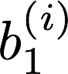
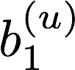
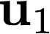
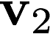
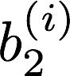
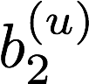












Slide 42
In neural network terms:
Each user is represented as a one hot vector (millions of dimensions big, though)
Each user is embedded as a low dimensional vector

Slide 43
A simple likelihood

Slide 44
A simple likelihood
We’ll remove biases to make the storyline simpler ;-)

Slide 45



A simple likelihood

Slide 46
A simple likelihood
(large) positive
zero
(large) negative

Slide 47
What should happen during optimization?
positive

Slide 48
A great solution...
Embeds all users and items, so that
The inner product between similar users / items is big: they are embedded in the same part of the space
The inner product between different users / items is negative: they are embedded in a different part of the space.
positive

Slide 49

A log likelihood / objective function
summing over all observed pairs

Slide 50




Matrix factorization, and a low-rank approximation

Slide 51

A regularized log likelihood

Slide 52


Gradient descent on L

Slide 53

Gradient descent on L

Slide 54
Gradient descent on L
Can you derive this? 5 minute class exercise.

Slide 55


Derivatives cheat sheet

Slide 56
scratch space for lectures

Slide 57


Slide 59
Gradient descent on L

Slide 61
We can set these partial gradients to zero, in parallel, for each of our millions of users...

Slide 66
Basic structure
repeat:
loop over users in parallel:
update user bias
update user trait vector u
loop over items in parallel:
update item bias
update item trait vector v

Slide 67
Bipartite graphs and distributed, parallel computations
Iterative least squares
Embarrassingly parallel updates
Distributed compute architectures (spread over many nodes in a data centre)
This gives us an idea of what physical architectures can support these kinds of algorithms

Slide 68


Class exercise
What does the update of look like? I.e. if we had:
sum over m here 😊 will fix

Slide 69

Class exercise
What does the update of look like? I.e. if we had:
sum over m here 😊 will fix

Slide 70


Class exercise
What does the update of look like with biases? I.e. if we had:

Slide 71

Class exercise
What does the update of look like with biases? I.e. if we had:
what’s the idea here?

Slide 72


Embeddings
Matchbox: Large Scale Bayesian Recommendations, Stern et al, WWW 2009
The Xbox Recommender System, Koenigstein et al, RecSys 2012

Slide 73


Slide 74
Initializing U and V
Rotational invariance of the embeddings

Slide 75
Some good properties
In the simplest version, we only need to
store one vector for each user
store one vector for each item
load a user’s vector at runtime
compute predictions over all items
...and return something (like the top)

Slide 76


Making predictions
Store vectors for each user and item
At runtime, compute inner products and rank largest to smallest

Slide 77
Evaluation: train, validation and test sets

Slide 78
Train, Validation and Test Datasets
Train Dataset – The sample of data used to fit the model. This is the actual data we use to train the model and learn parameters
Validation Dataset – The sample of data used to provide an unbiased evaluation of a model fit on the training dataset while tuning model hyperparameters. Models often have many hyperparameters (e.g., dimensionality, number of layers, architecture choices, optimization choices, etc.). The validation set is used only after the model is trained on the training dataset. It is used to evaluate the quality of the model under different hyper-parameter choices. Often the test dataset is used for tuning hyperparameters. However, as the model becomes biased towards this dataset, it is impossible to determine the actual quality of the model without a separate set.
Test Datasets – The sample of data used to provide an unbiased evaluation of a final model fit on the training dataset. The test set is used once at the very end to evaluate the actual performance of a recommender systems.

Slide 79

Train, Validation and Datasets Test Cont.
Most machine learning datasets are created by randomly splitting the data into train, validation and test.
Cross validation can be achieved by repeating the this split multiple times.
Recommendations datasets are time-dependent
The split usually follows the actual timeline of events
Random split usually yield an “easier” datasets that are not “realistic”

Slide 80



Dataset Partition - Coping with Long Tail Distributions
Recommendation datasets often exhibit a power-law distribution of ratings per items and per users.
We do not want the recommender system to be biased towards “heavy” users. Instead, we want the recommender system to “care” about all the users the same.
Removing ratings from heavy users or items is equivalent to deleting potentially useful data and changing user-item relations.
In many cases (e.g., Netflix, KDD Cup 2011), the last m ratings of each users are left for the validation set and the last n ratings are left for the test set.
Item 1
Item 2
Item 3
Item n
Item 1
Item k
Item 1
Item m
Train
Validation
Test

Slide 81
Practical 2
A model with biases only

Slide 82
Practical 2
✅ Download a smaller MovieLens dataset to develop and debug with, and again index it
✅ Split the small data set into a training and a test set.
You would need two sparse matrices with the same number of rows and columns:
data_by_user_train and data_by_user_test
data_by_movie_train and data_by_movie_test

Slide 83
Practical 2
✅ Build a model that finds maximum likelihood estimate for user + item biases with alternating least squares
✅ Plot the loss function (negative log likelihood) over training iterations, using data_by_user_train. It should go down monotonically!
Note that if you plotted the loss function using data_by_movie_train, the answers would be the same
✅ Plot the root mean squared error over training iterations, using data_by_user_train. What does it converge to?
✅ Plot the root mean squared error for data_by_user_test after each training iteration. What does it converge to? Does it follow the training error?

Slide 84
Practical 2: biases only
user_biases = np.zeros((M))
item_biases = np.zeros((N))
repeat:
loop over users in parallel:
update user bias
loop over items in parallel:
update item bias

Slide 85
Practical 2: biases only
✅ Your user + item biases code with alternating least squares will look like this:
user_biases = np.zeros((M))
item_biases = np.zeros((N))
repeat:
for m in 0 .. M-1:
bias = 0
item_counter = 0
for (n, r) in get_items_and_ratings_for_user(m):
bias += lambda * (r - item_bias[n])
item_counter += 1
bias = bias / (lambda * item_counter + gamma)
user_bias[m] = bias
# now do the same for the items
for n in 0 .. N-1:
...
After one (or a few) set(s) of updates, compute the current loss here on the training and test (or validation) set
…compute the current RMSE here on the training and test (or validation) set

Slide 86
Initializing U and V
Initializing U and V

Slide 87
Practical 3
A model with embeddings

Slide 88
Practical 3
✅ Add user and item factors (latent trait vectors or matrices U and V)
✅ Add a sensible regularizer to your loss function
✅ Build a model that finds maximum likelihood estimate for user + item biases + latent trait vectors / factors with alternating least squares using data_by_user_train and data_by_movie_train
✅ Plot the loss function (negative log likelihood) over training iterations using data_by_user_train. It should go down monotonically!
✅ Plot the root mean squared error over training iterations using data_by_user_train and data_by_user_test . What does it converge to?

Slide 89
Practical 3: with user and item vectors
✅ Your code with alternating least squares will look something like this:
repeat:
for m in 0 .. M-1:
...
for (n, r) in get_items_and_ratings_for_user(m):
sum things to update bias
user_bias[m] = ...
for (n, r) in get_items_and_ratings_for_user(m):
sum things to trait vector
user_vector[m,:] = ...
# now do the same for the items
for n in 0 .. N-1:
...
First update the user bias and then update the user vector.
A common coding bug is where everything is put in one loop!

Slide 90
Practical 4
Going big, training and testing

Slide 91
Practical 4
✅ Split the MovieLens 25M (or 32M) dataset into a training and a test set.
We won’t do cross-validation in this practical, but we will check whether we are overfitting on a test set! How will you create a sensible split?
✅ Adapt your code so that you only use the training set for optimizing parameters. Measure the RMSE on the training set and test set!
Plots the train and test RMSE on the same axis as you progress. Can you show where overfitting happens?
Is there more overfitting with K=20 latent dimensions than K=10? Or not? For which users? Is there underfitting anywhere? Do changes of λ and τ affect this?
✅ If you have settings of K, λ and τ that you like, train on the full dataset (next)

Slide 92
Practical 4
✅ Train on all 25M (or 32M) ratings. You may have to make your algorithm parallel to get this to train faster :)
✅ Show that if a user liked movie X (your choice) the recommendations Y make sense.
That is, create a “dummy user” that gave some movie like a “Lord of the Rings” five stars. Are the top recommendations other “Lord of the Rings” movies? You’ll need the 25M dataset for this to start looking really nice.
✅ Can you find and show which movies as polarizing?
Some polarizing that quickly narrows down a user’s taste once you know whether they like / dislike it. Typically movies with unusually long trait vectors v

Slide 93
Practical 4
Tricks of the trade:
Create a “dummy user” that gave some movie like a “Lord of the Rings” five stars. Are the top recommendations other “Lord of the Rings” movies? You’ll need the 25M dataset for this to start looking really nice. You used something like:
score_for_item[n] = user_trait_vector[m].inner(item_trait_vector[n]) + item_bias[n]
for all movies n. (Your recommendation score for a user is independent of the user bias, hence you didn’t add that.) This will not look nice because some “high bias” or popular movies will invariably always sit at the top. To increase the personalization component, try ranking with
score_for_item[n] = user_trait_vector[m].inner(item_trait_vector[n]) + 0.05 * item_bias[n]
where the contribution of the item bias is downplayed.
✅ Experiment! What works?

Slide 94
Practical 4
Tricks of the trade:
After ranking on:
score_for_item[n] = user_trait_vector[m].inner(item_trait_vector[n]) + 0.05 * item_bias[n]
you may still see some strange movies at the top of the list. They would be movies with, say, less than 100 ratings in your training data set. Filter them out to get cleaner results.
✅ Experiment! Does it make a difference? Let’s explore why on the next slides…

Slide 95
Making predictions
Store vectors for each user and item
At runtime, compute inner products and rank largest to smallest

Slide 96
Making predictions
...but it will not look like this!
why not?

Slide 97
Degree distributions
d=1
d=2
d=1
d=1
d=2
d=2
d=1
d=2
d=2

Slide 98
Power laws

Slide 99

Making predictions
...but it will not look like this!
why not?
Overfitting, somewhere!
Ranking, say, 100,000 movies… Some “rare” movies trickle to the top!
Latent dimensionality for factors, e.g.
could be small

Slide 100


Slide 101

Averaging over the posterior distribution
Remedy: average over all plausible settings of U and V...
Marginalization!

Slide 102

Averaging over the posterior distribution
Remedy: average over all plausible settings of U and V...
Bayes’s theorem

Slide 103
Averaging over the posterior distribution
Remedy: average over all plausible settings of U and V...
Marginalization!
With a “point mass” on U and V, like we had earlier, this is still analytically tractable. Now it is not.

Slide 104
Averaging over the posterior distribution
We can approximate this integral
Draw samples from the posterior (Markov chain Monte Carlo; block Gibbs sampling), offline
Store samples for each user and item on disk, and approximate the integral
Problem: memory on disk scales with the number of samples
Problem: online evaluation time scales with the number of samples
Remedy: average over all plausible settings of U and V...
Marginalization!

Slide 105
Mean field approximation
We want to approximate
with a factorized distribution, so that we now keep a mean and variance per dimension...
...so that we can still store a vector (or now, two vectors) of numbers per user and item (small memory footprint on disk)
Mean field variational inference

Slide 106

Mean field approximation
Optimize a variational lower bound to the log marginal likelihood:
Maximization is over q(U) and q(V)

Slide 107
Mean field approximation
Optimize a variational lower bound to the log marginal likelihood:
Maximization is over q(U) and q(V)

Slide 108
Mean field approximation
Optimize a variational lower bound to the log marginal likelihood:
Maximization is over q(U) and q(V)

Slide 109



Slide 110
Conjugate exponential family
Component-wise gradient descent on distributions q have a particularly nice closed form solution
(a bit like the maximum a posteriori case earlier)
...and has the same form / complexity as Gibbs sampling updates if we were to sample
from the posterior

Slide 111

Making predictions
We capture some notion of posterior uncertainty
Fully factorized posterior approximation

Slide 112
Inference

Slide 113






A very simple example!
One user, one item, one rating

Slide 114





The joint density
Increasing …

Slide 115


The joint density
Increasing …
0
1
2

Slide 116
Class practical
Understanding the joint density

Slide 117
Recreate the figures :)
u = np.arange(-5, 5, 0.25)
v = np.arange(-5, 5, 0.25)
U, V = np.meshgrid(u, v)
P = np.exp(- 0.5 * tau * (U**2 + V**2) ... )
# correct and fill in ...!
surf = plt.contourf(U, V, P, ...)

Slide 118
scratch space for lecture

Slide 119
Variational Bayes

Slide 120



A variational approximation

Slide 121







Slide 122


Objective function

Slide 123
Objective function

Slide 124


Free-form minimization; let be any non-negative function
Lagrange multiplier: q should integrate to one!
Functional derivative
Set to zero…
Normalization comes from solving for the Lagrange multiplier

Slide 125
Free-form minimization; let be any non-negative function
Lagrange multiplier: q should integrate to one!
Functional derivative
Set to zero…
Normalization comes from solving for the Lagrange multiplier

Slide 126
Free-form minimization; let be any non-negative function
Lagrange multiplier: q should integrate to one!
Functional derivative
Set to zero…
Normalization comes from solving for the Lagrange multiplier

Slide 127
Free-form minimization; let be any non-negative function
Lagrange multiplier: q should integrate to one!
Functional derivative
Set to zero…
Normalization comes from solving for the Lagrange multiplier

Slide 128

(The Lagrange multiplier)

Slide 129
Approximation, maximum a posteriori, etc.

Slide 130
A variational approximation

Slide 131







Slide 132

Pitchfork bifurcations
solutions axis
(e.g. approximation means)
parameter axis, (e.g. r)

Slide 133

A variational update

Slide 134
A variational update

Slide 135
A variational update

Slide 136
A variational update

Slide 137
A variational update

Slide 138
A variational update

Slide 139

A variational update

Slide 140
A variational update
Compare to

Slide 141

A variational update
Compare to

Slide 142


Gibbs sampling (Markov chain Monte Carlo)
Repeat:
Sample
Sample
Use samples in empirical average

Slide 143


Slide 144


Slide 145


Slide 146


Slide 147
Going back to a
production system…
Implicit feedback

Slide 148
Practical point
✓
✓
Implicit feedback
“One-class collaborative filtering”
✓
✓
✓
✓
There are many other signals (count; temporal; contextual features) which we’ll ignore until later...
✓

Slide 149

Practical point
✗?
✓

Slide 150
Practical point
✗?
✓
Random unobserved “negative” graph: the content that a user dislikes
(We write the likelihood as an expectation over all possible negative graphs, where the “negative graph” follows the same power law distribution as the observed graph)
Stochastic gradient descent over samples from such graphs

Slide 151
Practical point
✓
✗?
Stochastic gradient descent step 1

Slide 152
Practical point
✗?
✓
Stochastic gradient descent step 2
etc...

Slide 153
A basic version is (almost) production-ready!
In the first-cut version, we only need to
store a mean and variance vector for each user, plus biases
store a mean and variance vector for each item, plus biases
load a user’s vector at runtime
compute predictions over all items
...and return something (like the top)
One-class Collaborative Filtering with Random Graphs
Paquet + Koenigstein, WWW 2013

Slide 154
Adding Features

Slide 155
Better priors
[ adventure, animated, boys, cars, kids ]
[ 0 1 1 0 0 1 0 0 0 0 0 1 0 0 0 1 0 0 0 0 ]
If we have features for some content, and there might be some correlation between features and usage patterns:
Learn which features are useful for predictions
Hierarchical Bayesian model:
[ adventure, animated, anti-hero, kids ]
[ 0 1 1 0 1 0 0 0 0 0 0 0 0 0 0 1 0 0 0 0 ]
prior → items → usage ← user ← prior
prior → features → items → usage ← user ← prior

Slide 156

Better priors
[ adventure, animated, boys, cars, kids ]
[ 0 1 1 0 0 1 0 0 0 0 0 1 0 0 0 1 0 0 0 0 ]
Hierarchical prior:
[ adventure, animated, anti-hero, kids ]
[ 0 1 1 0 1 0 0 0 0 0 0 0 0 0 0 1 0 0 0 0 ]
p(v|F)

Slide 157

Adding features: loss function without features

Slide 158

Adding features: loss function with features

Slide 159
Adding features: loss function with features

Slide 160
Scratch space

Slide 161

Posterior means for each feature
This shares prior information, and helps with the “cold start” problem...

Slide 162

Probabilistic graphical model
u
v

Slide 163
Practical 5
Adding features

Slide 164
Practical 5 | optional extra
What to do with side information and additional features?
✅ Build genre information like
into your Alternating Least Squares (explicit feedback) or Bayesian Personalized Ranking (implicit feedback) model
Ideas discussed in session are from the XBox system
✅ How does it help the cold start problem? (When a movie has no ratings, but you still want to predict it)
Dataset examples
movies.csv
movieId,title,genres
1,Toy Story (1995),Adventure|Animation|Children|Comedy|Fantasy
2,Jumanji (1995),Adventure|Children|Fantasy
3,Grumpier Old Men (1995),Comedy|Romance

Slide 165
Practical 5 | Code with user, item and feature vectors
✅ Your code with alternating least squares will look something like this:
repeat:
# update user biases and vectors
for m in 0 .. M-1:
...
for (n, r) in get_items_and_ratings_for_user(m):
...
# now do the same for the items
for n in 0 .. N-1:
...
# now update feature vectors
for i in 0 .. num_features-1:
...

Slide 166
By: Yvan Marcel CARRÉ VILMORIN, AIMS 2024

Slide 167
By: Yvan Marcel CARRÉ VILMORIN, AIMS 2024

Slide 168
By: Emmanuel Kwame Ayanful, AIMS 2025

Slide 169
By: Isaac Houngue, AIMS 2025

Slide 170
Mixture models and multiple users

Slide 171

Optimizing for a slate
Xbox 360, some time ago...

Slide 172

Optimizing for a slate
Uncertainty counts! If we’re not certain if someone is going to click on an item in a slate, it is better to diversify…
But if we are certain, then we place two similar items

Slide 173
Implicit feedback: ranking problem!

Slide 174
Practical 6
Ranking

Slide 175
Practical 6 | Reading list
Read:
✅ BPR: Bayesian Personalized Ranking from Implicit Feedback
✅ One-class Collaborative Filtering with Random Graphs
✅ Dive into Deep Learning, chapter 16.5

Slide 176
Practical 6
✅ Assume that the data implicit feedback data (your own conversion)
✅ Code BPR (Bayesian personalised ranking) using the SGD framework
✅ Repeat practical 1 on Movielens, but with stochastic gradient descent instead of alternating least squares
✅ Discuss and analyse of differences (with alternating least squares)

Slide 177

Practical 6
✅ Use precision@k and recall@k to show that your BPR algorithm works
Ranking Induced by Algorithm
Ground Truth
Positive Result 3
Positive Result 1
Negative Result
Positive Result 2
Positive Result 1
Positive Result 3
Negative Result
Positive Result 2

Slide 178
Bird’s eye

Slide 179
Feedback types
Explicit feedback
5-star scale (e.g., Netflix)
0-100 scale (e.g., Yahoo! Music)
Binary- thumb up/down
Implicit feedback
Watching a movie
Purchasing an app
Clicking on an article
Skipping a song (negative?)

Slide 180
Issues with explicit signals (1)
Explicit signals (usually) do not exist
Many systems do not have an interface for ratings
Even when a rating system is in place, there is often much more implicit feedback than explicit ratings
Ratings of the same movie can change when the order of ratings change

Slide 181
Issues with explicit signals (2)
Missing not at random!
People rate what they watched
If it’s not in your “taste” you will not care to rate it
Negative values are still a positive indication (because the fact that you watched a movie is a positive indication even if you gave it a low rating)
See Benjamin Marlin et al., Collaborative Filtering and the Missing at Random Assumption

Slide 182
Issues with explicit signals (3)
Context matters
Ratings of the same movies change when the order of the ratings change
For example, if the first movie is great, the entire session might be rated lower than if the first movie is terrible
Users change their perspectives after some time
For example, movie reviews and perception influence user ratings
A bias can occur between users who rated immediately after watching when the movie was released and users who rate long after watching a movie

Slide 183
Issues with explicit signals (4)
Much of the signal is “hidden” in biases
For example in the Netflix dataset as well as in Yahoo! Music there is more signal in modeling user and item biases than in the actual user-item personalization signal

Slide 184
R² in explicit RMSE-based collaborative filtering datasets
R² coefficient of determination
One minus the ratio of the model’s MSE to the total variance in the dataset
R² = 1 - MSE / Var
A simple model that predicts the mean rating value achieves R² = 0
Positive values indicate an improvement over the mean baseline
Negative values indicate that the model is “garbage”

Slide 185
R² in explicit RMSE-based CF datasets
Biases are the main factor in explaining a user’s rating. No personalization gets you far!
Netflix Prize:
total variance: 1.276
winning model: 0.73 (RMSE of 0.85)
R² = 0.43 of which 0.33 are attributed to biases alone
Yahoo! Music (for KDD Cup ’11):
total variance: 1084.5
final model: 510.3 (RMSE of 22.59)
R² = 0.53 of which 0.41 are attributed to biases alone
Yahoo! Music Recommendations: Modeling Music Ratings with Temporal Dynamics and Taxonomy Gideon Dror, Noam Koenigstein and Yehuda Koren

Slide 186
Issues with implicit feedback signals (1)
No negative feedback is available implicitly
Most of the implicit feedback is positive
For example, if a user didn’t watch a movie it doesn’t mean she didn’t like it
It’s a one-class problem, not a binary classification problem
Sometimes implicit signals are cumulative (listening to a song multiple times) but unlike ratings, there is no scale and no maximum value

Slide 187
Issues with implicit feedback signals (2)
Implicit feedback is more noisy
Sometimes, people purchase things purely because they are on sale
One one platform, people consume content that’s not available on another platform, hence making them appear more similar
Evaluation is less straightforward

Slide 188
Explicit vs Implicit Feedback
Explicit Feedback | Implicit Feedback
Explicit ratings of users to items | Implicit user actions indicating interest
Examples: 5-star scale, 0-100, thumb up/down (binary) | Examples: Purchase signals, clicks, playing games or music, skipping songs, watching movies, stopping in the middle of a movie,
Rare to find | Abundant in almost any company with users
Users are inconsistent among themselves and across time | Tend to follow a more “stable” behavior
Regression models | Binary models, Ranking models, Triplet loss models, One-class models
Evaluation: RMSE, MAE, etc. | Evaluation: MPR, MRR, Hit Rate, Precision@K, Recall@K, etc
Original models (Netflix Prize, KDD 2011) | Most recent recommender systems models
Much of the work is modelling biases | More inline with actual user preferences
Notes:
Important for the test

Slide 189
Prominent Implicit Feedback Papers
Collaborative Filtering for Implicit Feedback Datasets Y. Hu, Y. Koren, C. Volinsky
Implicit-to-Explicit Ordinal Logistic Regression D. Parra, A. Karatzoglou, X. Amatriain, I. Yavuz
BPR - Bayesian Personalized Ranking S. Rendle, C. Freudenthaler, Z. Gantner, and L. S. Thieme
RankALS – Alternating Least Squares for Personalized Ranking G. Takacs, D. Tikk
CLiMF – Reciprocal Rank Optimization Y Shi, A. Karatzoglou, L. Baltrunas, M. Larson, N. Oliver, A. Hanjalic
Notes:
1) Implicit Feedback – AT&T Labs / Yifan Hu + winner of Netflix. A binary model where all the things the user considers equals 1 and the rest equals 0.
2) Implicit-to-Explicit Ordinal Logistic Regression – University of Pittsburgh and Telefonica. Ordinal LR for Pr(r_ui<K)=alpha_k+x*w
3) BPR – University of Hildesheim Pr(xy>xz)
4) RankALS – Hungarian researchers Takacs and Tikk🡪 Optimizing the ranking objective without sampling – Minimizing the error of the predicted difference of ratings (with respect to the actual difference of ratings)
5) CLiMF – Delft University + Telefonica (http://baltrunas.info/papers/Shi12-climf.pdf). Optimizing the Mean Reciprocal Rank (MRR) directly. Instead of a proxy…

Slide 190

Blackboard class explanation

Slide 192


Slide 193
Evaluation

Slide 194
Precision@k / Recall@k
Ranking Induced by Algorithm
Ground Truth
Positive Result 3
Positive Result 1
Negative Result
Positive Result 2
Positive Result 1
Positive Result 3
Negative Result
Used for: Implicit Feedback
Positive Result 2

Slide 195

Mean Average Precision
We can plot precision as a function of recall
Ranking Induced by Algorithm
Positive Result 3
Negative Result
Average Precision
Positive Result 1
Positive Result 2
Notes:
In real life the precision values are very low. In order to reach recall=100% you have to reach very high k -> extremely low precision values.

Slide 196


NDCG@k - Normalized Discounted Cumulative Gain
Ranking Induced by Algorithm
Ground Truth
Positive Result 3
Positive Result 1
Relevance: 5
Negative Result
Positive Result 2 Relevance: 3
Positive Result 1
Positive Result 3
Relevance: 1
Positive Result 2
Used for: Implicit Feedback
Notes:
IDCG – Ideal DCG
If a different algorithm were to swap the 1st and 3rd items -> DCG@3=5.5 instead of 3.5

Slide 197

MPR - Mean Percentile Rank
Sometimes there is only one “positive” item in the test set…
Ranking Induced by Algorithm
Ground Truth
Positive Result 3
Negative Result
Positive Result 1
Negative Result
Lower is Better !
Positive Result 1
Positive Result 2
Used for: Implicit Feedback
Negative Result

Slide 198

Online experiments
Randomized controlled experiments
Measure KPIs (Key Performance Indicator) directly
Can compare several variants simultaneously
The ultimate evaluation technique!

Slide 199

Causality: data vs the HiPPO
A
B

Slide 200
Causality, A/B testing!
Does my model cause a change in a KPI (key performance indicator)?
Which changes should we deploy?
We need the right logging here: experiment ID + random user partition (A or B) + feedback...

Slide 201

Resources
A/B testing!
Ron Kohavi’s lectures on A/B testing
To watch: KDD 2015 Keynote talk and KDD 2015 Keynote slides PDF
Useful to read
Unexpected Results in Online Controlled Experiments
Seven Pitfalls to Avoid when Running Controlled Experiments on the Web
Practical Guide to Controlled Experiments on the Web: Listen to Your Customers not to the HiPPO
Controlled experiments on the web: survey and practical guide

Slide 202
Class work for Monday 28 July
All: Ron Kohavi’s lectures on A/B testing
All: To watch: KDD 2015 Keynote talk and KDD 2015 Keynote slides PDF
In 4 groups, each present (20 minutes each)
Unexpected Results in Online Controlled Experiments
Seven Pitfalls to Avoid when Running Controlled Experiments on the Web
Practical Guide to Controlled Experiments on the Web: Listen to Your Customers not to the HiPPO
Controlled experiments on the web: survey and practical guide

Slide 203

Class work for Tuesday 13 February
Bonus! If you want a step-up, dip into Léon Bottou et al’s classic:
Counterfactual Reasoning and Learning Systems: The Example of Computational Advertising

Slide 204
Experimentation caveats
What KPI to measure?
How long to run the experiment?
External factors may influence the results
Cannibalization is hard to account for
Expensive to implement
Can’t compare algorithms before “lighting up”

Slide 205
Practical 7
Building in A/B testing

Slide 206
Practical 7
✅ Wrap either of practicals 1 and 2 in a system (a bit of code or API that could serve recommendations), e.g.
def createreco(userid, …) -> List[Tuple[int,str]]: ….
Here Tuple[int,str] says that we return the movie id and title
✅ Add a bit of code to simulate a user giving feedback on the list, and based on that:
✅ Add basic “logging” to your system (i.e. write user id, item id and feedback to disk, for example a CSV file)

Slide 207
Practical 7
✅ Create (say 100) dummy users and simulate new interactions from them (through some rule that you make up)
A/B testing!
✅ Change one thing in your model, e.g. down-weighing item biases when making recommendations. Now we have two versions, your original and one with the tweak!
Let your API take in a model id so that you could serve a list depending on whether the user is in group A or B:
def createreco(userid, versionid) -> List[Tuple[int,str]]: ….
✅ Expand your basic “logging” to also write the model id to disk (e.g. user id, item id, feedback, version id)

Slide 208
Practical 7
A/B testing! (continued)
✅ Randomly split your users into A and B, and do a controlled trial. Simulate them giving feedback. Remember to track the version id: either A or B!
✅ Write each feedback as a line to CSV
✅ Is A or B better?
Show how you measure!

Slide 209
Optimize, optimize, optimize the user experience and other KPIs
using data
lots of data

Slide 210
📚 Final report 📚

Slide 211
📚 Final report 📚
The course contains four practicals, running over three weeks. The practicals will help you derive, code and demonstrate your own prototype of a recommender system using the MovieLens dataset.
You will be evaluated on a final technical report that showcases your recommendation engine prototype and all the steps you took to build (and understand) it. It should include detailed equations, derivations, figures, and illustrative and real predictions.

Slide 212
📚 Final report 📚
The final report should be at least 8 pages long (without technical appendices). You are welcome to structure it so that it contains “technical appendices” at the end, if there are particularly long derivations that you would like to add.
Your source code should accompany your report, and should be:
saved in Github and
shared with Github user upaq
Please also mention your Github source repository link at the end of your “abstract” of the report.

Slide 213

📚 Final report 📚
This is a practice round for wrapping up real research, so…
…your research article should follow the AIMS-ICML Style Guide
We’re not really going to submit to ICML 😊; this is the “learning round”!

Slide 214
📚 Final report 📚
Things you should at least cover in your report:
✅ Introduction and some past work
✅ The problem statement
✅ Data set plots (power laws, ratings distributions)
✅ A write-up of all your models
✅ A long results section!
Include results from Practicals 1 to 75

Slide 215
📚 Final report: results 📚
Your results section should contain:
✅ Description of train / test set split
✅ Alternating Least Squares (ALS), biases only. Root Mean Square Error (RMSE) results on any MovieLens dataset, train and test
✅ ALS, biases + U, V matrices (user and movie trait vectors). RMSE results on any MovieLens dataset, train and test

Slide 216
📚 Final report: results 📚
✅ Plots of the loss function over training iterations. It should go down monotonically! Or monomotically up if you take the regularized log likelihood 😄
✅ 2D embeddings of the “item trait vectors” v_{n}, showing that similar movies are embedded together and opposite movies are embedded in “opposite” parts of the space. You’d have to include biases in your training here and use 2D trait vectors in U and V, and then plot the 2D vectors in V for a selection of movies

Slide 217
📚 Final report: “model” section and results 📚
✅ Use the MovieLens genres metadata
movies.csv
movieId,title,genres
1,Toy Story (1995),Adventure|Animation|Children|Comedy|Fantasy
2,Jumanji (1995),Adventure|Children|Fantasy
3,Grumpier Old Men (1995),Comedy|Romance
as part of your model. Describe your altered loss function in sufficient detail, including the optimization steps in the “modeling” section.
✅ For a model with two-dimensional trait vectors (2D latent dimensions), plot the learned embedding of the genre trait vectors, and reason how it makes sense.

Slide 218
📚 Final report 📚
✅ Describe and show how many ALS training iterations you used. Why?
✅ Describe and show how hyperparameters were chosen, e.g. λ and τ
✅ Describe and show how you chose the “best” number of latent dimensions for your model, and at which point you achieved diminishing returns
Hint: You can try K = 0, 2, 4, 8, 16 and possibly 32. Don’t bother with K = 50 or 100 or other huge numbers; you’ll just spend most of your time waiting for your algorithm to converge.

Slide 219
📚 Final report: results 📚
✅ Can you show results on all 32M ratings, including implementation to make your algorithm run faster than the most naive implementation
✅ Show that if a user liked movie X (your choice) the recommendations Y make sense
For instance, create a “dummy user” that gave some movie like a “Lord of the Rings” five stars. Are the top recommendations other “Lord of the Rings” movies? You’ll need the 25M dataset for this to start looking really nice.
🍒 Yes, this is the cherry on the cake! 🎂 You have to show this if you want to “impress”! See the last slide of Practical 4

Slide 220
📚 Final report: results 📚
Usually, in modern machine learning papers, there is a link to publicly accessible code so that anyone could reproduce your work.
Please include:
✅ A Github reference to legible ALS (and other) code that you wrote yourself
✅ Nice code in Github (e.g. PEP 8 for Python)

Slide 221
📚 Final report 📚
23
The marks breakdown of the final report is as follows:
✅ 5% Data set plots (power laws, ratings distributions)
✅ 4% Alternating Least Squares (ALS), biases only. Root Mean Square Error (RMSE) results on any MovieLens dataset
✅ 3% If there are additional results on a train / test set split that you devised
✅ 8% ALS, biases + U, V matrices (user and movie trait vectors). RMSE results on any MovieLens dataset
✅ 3% If there are additional results on a train / test set split
In real life you might use a train / validation / test split of your data to ensure that you don’t accidentally overfit on your test set

Slide 222
📚 Final report 📚
21
✅ 3% Plots of the negative loss function over training iterations. It should go up monotonically! Or monomotically down if you don’t take minus 😄
✅ 9% Legible ALS (and other) code that you wrote yourself
✅ 4% Coding style (e.g. PEP 8 for Python)
✅ 5% 2D embeddings of the “item trait vectors” v_{n}, showing that similar movies are embedded together and opposite movies are embedded in “opposite” parts of the space. You’d have to include biases in your training here and use 2D trait vectors in U and V, and then plot the 2D vectors in V for a selection of movies

Slide 223
📚 Final report 📚
7
✅ 7% Use the MovieLens genres metadata
movies.csv
movieId,title,genres
1,Toy Story (1995),Adventure|Animation|Children|Comedy|Fantasy
2,Jumanji (1995),Adventure|Children|Fantasy
3,Grumpier Old Men (1995),Comedy|Romance
as part of your model. Describe your altered loss function in sufficient detail, including the optimization steps.
For a model with two-dimensional trait vectors (2D latent dimensions), plot the learned embedding of the genre trait vectors, and reason how it makes sense.

Slide 224
📚 Final report 📚
16
✅ 9% Bonus if your results are on all 32M ratings, including an implementation to make your algorithm run faster than the most naive implementation
✅ 5% Show that if a user liked movie X (your choice) the recommendations Y make sense
For instance, create a “dummy user” that gave some movie like a “Lord of the Rings” five stars. Are the top recommendations other “Lord of the Rings” movies? You’ll need the 25M dataset for this to start looking really nice.
✅ 2% What are the most polarizing movies? And the least polarizing movies? Did you make your claim without overfitting being an explanation?
Some polarizing that quickly narrows down a user’s taste once you know whether they like / dislike it. Typically movies with unusually long trait vectors v

Slide 225
📚 Final report 📚
8
✅ 4% Describe and show how hyperparameters were chosen, e.g. λ and τ
✅ 4% Describe and show how you chose the “best” number of latent dimensions for your model, and at which point you achieved diminishing returns

Slide 226
📚 Final report 📚
15
✅ 7% Show a practical algorithm at work on implicit feedback data, evaluated with Precision@k and Recall@k for different values of k (say 10, 20, 100).
You could take all 4+ ratings on MovieLens 25M as the implicit positive signal, and ignore the rest. Code Bayesian Personalized Ranking (BPR) to illustrate a ranking-based loss function.
Your results might not look that good due to your creation of data – your model is not trained on real implicit feedback data – but you can show that you understand how implicit feedback data is modeled.
✅ 5% Show, through code of a mocked up system, how you would implement an A/B test on your users.
✅ 3% Show a simulated A/B test with any algorithmic change, including the t-test to see if your change makes a statistically significant difference

Slide 227
📚 Final report 📚
17
✅ 10% Writing, writing, writing 😄. A clean layout with an introduction, logical sections and subsections, neatly typeset equations with correct sub-indexing, correctly numbered figures that are referenced in the text, etc. LaTeX is your friend.
💯 100 The brings you to 100%. You can go above and beyond and squeeze in bonus marks 😄:
✅ 7% Optional self-work bonus: Go beyond a “single point” estimate when inferring the parameters of U, V and the biases b, and implement a Variational Bayes solution. Present your derivations, code and results

Slide 228

The End

Slide 229
Evaluation of Recommender Systems

Slide 230
Train, Validation and Test Datasets
Train Dataset – The sample of data used to fit the model This is the actual data we use to train the model and learn parameters
Validation Dataset - The sample of data used to provide an unbiased evaluation of a model fit on the training dataset while tuning model hyperparameters. Models often have many hyperparameters (e.g., dimensionality, number of layers, architecture choices, optimization choices, etc.). The validation set is used only after the model is trained on the training dataset. It is used to evaluate the quality of the model under different hyper-parameter choices. Often the test dataset is used for tuning hyperparameters. However, as the model becomes biased towards this dataset, it is impossible to determine the actual quality of the model without a separate set.
Test Datasets - The sample of data used to provide an unbiased evaluation of a final model fit on the training dataset. The test set is used once at the very end to evaluate the actual performance of a recommender systems.
Definitions taken from Jason Brownlee’s article: What is the Difference Between Test and Validation Datasets?

Slide 231
Train, Validation and Datasets Test Cont.
Most machine learning datasets are created by randomly splitting the data into train, validation and test.
Cross validation can be achieved by repeating the this split multiple times.
Recommendations datasets are time-dependent
The split usually follows the actual timeline of events
Random split usually yield an “easier” datasets that are not “realistic”

Slide 232


Power-law Distributions in Recommendation Datasets
Notes:
Terms to know –
Power law distribution
Long Tail

Slide 233
Dataset Partition - Coping with Long Tail Distributions
Recommendation datasets often exhibit a power-law distribution of ratings per items and per users.
We do not want the recommender system to be biased towards “heavy” users. Instead, we want the recommender system to “care” about all the users the same.
Removing ratings from heavy users or items is equivalent to deleting potentially useful data and changing user-item relations.
In many cases (e.g., Netflix, KDD Cup 2011), the last m ratings of each users are left for the validation set and the last n ratings are left for the test set.
Item 1
Item 2
Item 3
Item n
Item 1
Item k
Item 1
Item m
Train
Validation
Test

Slide 234
What to do with features?
(also called side-information)

Slide 235
Various options…
Dataset examples
movies.csv
movieId,title,genres
1,Toy Story (1995),Adventure|Animation|Children|Comedy|Fantasy
2,Jumanji (1995),Adventure|Children|Fantasy
3,Grumpier Old Men (1995),Comedy|Romance

Slide 236


Slide 237


Slide 238


Slide 240
Reservoir sampling

Slide 241
Weighted reservoir sampling

Slide 243


Slide 244


Slide 245


Slide 246
Evaluation Techniques
Offline Evaluation Techniques
Issues with Offline Evaluation Techniques
Online Evaluation
Off-policy Evaluation

Slide 247


Notes:
Some results are more important than others.
We only need to find what the user likes! We don’t care to predict what she doesn’t like.
Long tail items are more important!

Slide 248


Notes:
But what if we don’t have ratings?

Slide 249

MAE - Mean Absolute Error

Slide 250

Ranking Induced by Algorithm
Ground Truth
Positive Result 3
Positive Result 1
Negative Result
Positive Result 2
Positive Result 1
Positive Result 3
Negative Result
Positive Result 2
Used for: Implicit Ratings

Slide 251

MPR in Xbox
Xbox Movies Recommendations: Variational Bayes Matrix Factorization with Embedded Feature Selection by Noam Koenigstein and Ulrich Paquet
Notes:
Ask students to explain what they see here…

Slide 252


Sometimes there is only one “positive” item in the test set…
Ranking Induced by Algorithm
Ground Truth
Positive Result 3
Negative Result
Positive Result 1
Negative Result
Higher is Better !
Positive Result 1
Positive Result 2
Used for: Implicit Ratings
Negative Result

Slide 253








Spearman’s Rank Correlation Coefficient
In scenarios where we want to emphasize the full ranking, we may compare the ranking of the algorithm to a reference ranking.
The Spearman correlation coefficient is defined as the Pearson correlation coefficient between the rank variables.
Ground Truth Ranking
Ranking Induced by Algorithm
Result 3
Result 1
Result 2
Result 4
Result 3
Result 1
Result 4
Result 2

Slide 254


Kendall’s Rank Correlation Coefficient
In scenarios where we want to emphasize the full ranking we may compare the ranking of the algorithm to a reference ranking
Ground Truth Ranking
Ranking Induced by Algorithm
Result 3
Result 1
Result 2
Result 4
Result 3
Result 1
Result 4
Result 2
Notes:
Full ranking – preserving order between each pair of items.

Slide 255
Offline Techniques – Open Questions
How do we measure the importance/ relevance of the positive items?
Long tail items are more important. But how do we quantify?
How many items do we care to recommend?
Should the best item be the first item?
Maybe the best item should be in the middle?
What about diversity?
What about contextual effects?
What about items fatigue?
Notes:
If you just write academic papers, this is basically all you need to know.
You may care about how these measures are changed with respect to the item’s popularity or the amount of knowledge you have on the user…. So you can break down these results according to popularity.
How many items do we care to recommend? – Even if the list is of size k, we often want to refresh it and show more new items, so we need several lists of size k. How much? How do we refresh?

Slide 256
Classical Categorization of Recommender Systems
Collaborative Filtering vs Content Based
Types of CF Algorithms
CF Examples
CB Examples

Slide 257
Classical Categorization of Recommender Systems
Collaborative Filtering (CF) Methods:
Recommend Items Liked by Similar Users
Doesn’t use items meta-data, attributes, explicit features or “content”
Favors popular content
Suffers from the items/ users “cold-start” problem
Content Based (CB) Methods:
Uses attributes of users / items
Recommends items that are similar to those liked/purchased by the user in the past
Generally, considered less accurate than CF methods
Requires items attributes (content) but does not suffer from “cold-start”
Hybrid Models:
Utilize both CF information as well as CB information for better recommendations
Many Deep Learning models are dealing with “multi-views”
Usually, the contribution of the CB information is negligible in the presence of CF inforamtion

Slide 258
Types of Collaborative Filtering Algorithms
Memory Based CF:
The memory-based approach uses user rating data to compute the similarity between users or items. Typical examples of this approach are neighbourhood-based CF.
Model Based CF:
In this approach, models are developed using different data mining, machine learning algorithms to predict users' rating of unrated items. The most prominent approach is Matrix Factorization (MF).
Deep Learning Methods:
In recent years a number of neural and deep-learning techniques have been proposed. Some generalize traditional Matrix factorization algorithms via a non-linear neural architecture, or leverage new model types like Variational Autoencoders.
While deep learning has been applied to many different scenarios: context-aware, sequence-aware, social tagging etc. its real effectiveness when used in a simple collaborative recommendation scenario has been put into question. A systematic analysis of publications applying deep learning or neural methods to the top-k recommendation problem, published in top conferences (SIGIR, KDD, WWW, RecSys), has shown that on average less than 40% of articles are reproducible. Ferrari Dacrema, Maurizio; Cremonesi, Paolo; Jannach, Dietmar (2019). "Are We Really Making Much Progress? A Worrying Analysis of Recent Neural Recommendation Approaches". Proceedings of the 13th ACM Conference on Recommender Systems. ACM: 101–109.

Slide 259
CF Examples – Neighborhood Models
Item Based Neighborhood Model:
Compute item-to-item similarities matrix
For each user, find the most similar items to the items she liked
User Based Neighborhood Model:
Compute user-to-user similarity matrix
For each user, find her most similar users and recommend items that these users liked, but she did not consumed yet.

Slide 260

Pointwise Similarity Functions

